Slide 1
RATING REGRESSION
PINAK SHOME

Slide 2
OBJECTIVES AND SIGNIFICANCE
PREDICT OVERALL RATINGS OF SOCCER PLAYERS GIVEN A SET OF PLAYER ATTRIBUTES
EXPLORE THE NUANCES OF HOW DIFFERENT MACHINE LEARNING MODELS UNDERGO THE PROCESS OF REGRESSION LEARNING
HELPS SCOUTING ORGANIZATIONS CLASSIFY PLAYERS AND PREDICT PERFORMANCES BASED ON ATTRIBUTES AVAILABLE
UNCOVER THE POTENTIAL OF MACHINE LEARNING IN SPORTS ANALYTICS
CONTRIBUTES TO THE OVERALL INCREASE IN THE LEVEL OF THE GAME

Slide 3
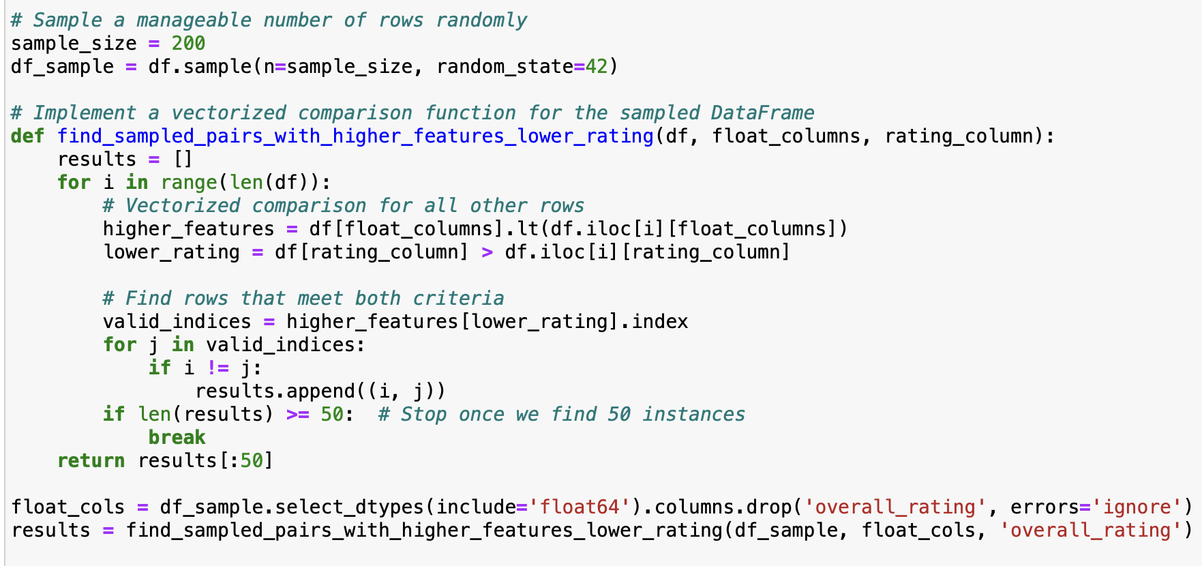
RESEARCH QUESTIONS
WHAT PREDICTS A PLAYER’S OVERALL RATING AND HOW CAN THESE BE USED TO INFORM TALENT SCOUTING AND TEAM BUILDING?
ROLE OF PHYSICAL VS SKILL ATTRIBUTES IN DETERMINING A PLAYERS RATING
EXPLORING THE LEARNING POWER OF ML MODELS GIVEN A DATASET WHERE THE VARIABLES ARE NOT NECESSARILY STRONG INDICATORS OF THE OUTCOME VARIABLE

Slide 4
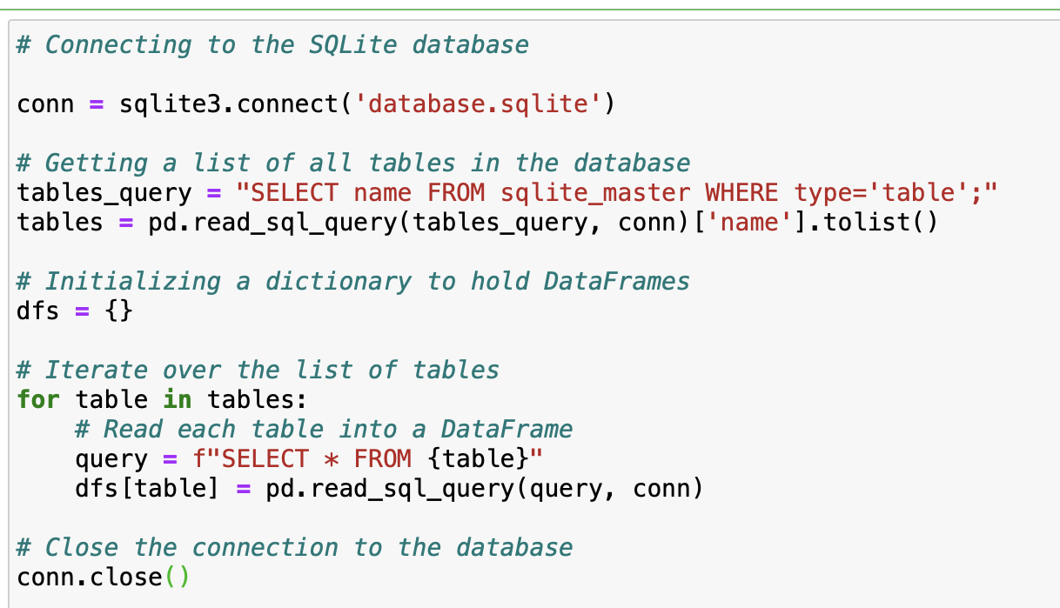
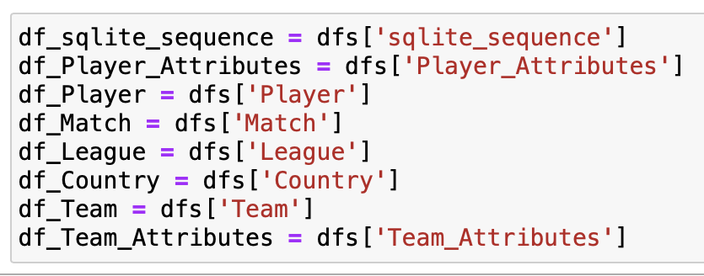
DATASET SCHEMA
ORIGINALLY IN A .SQLITE FILE, CREATED A DICT WITH TABLE NAMES AS KEYS TO EXTRACT THEM OUT AS SEPARATE DFS

Slide 5
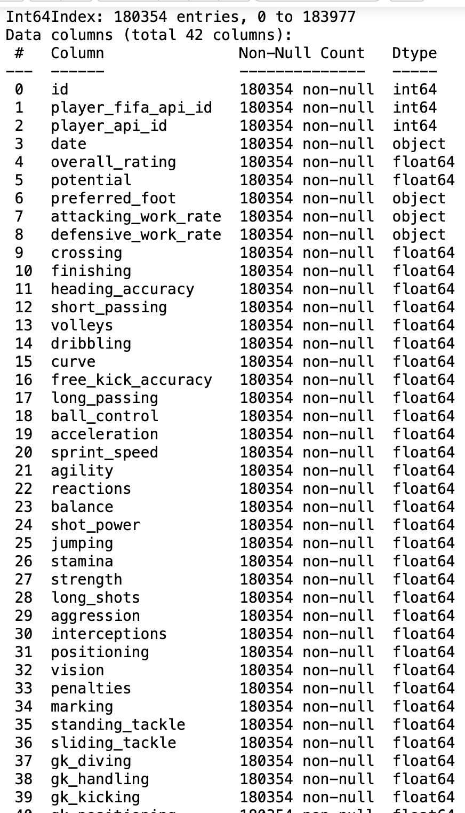
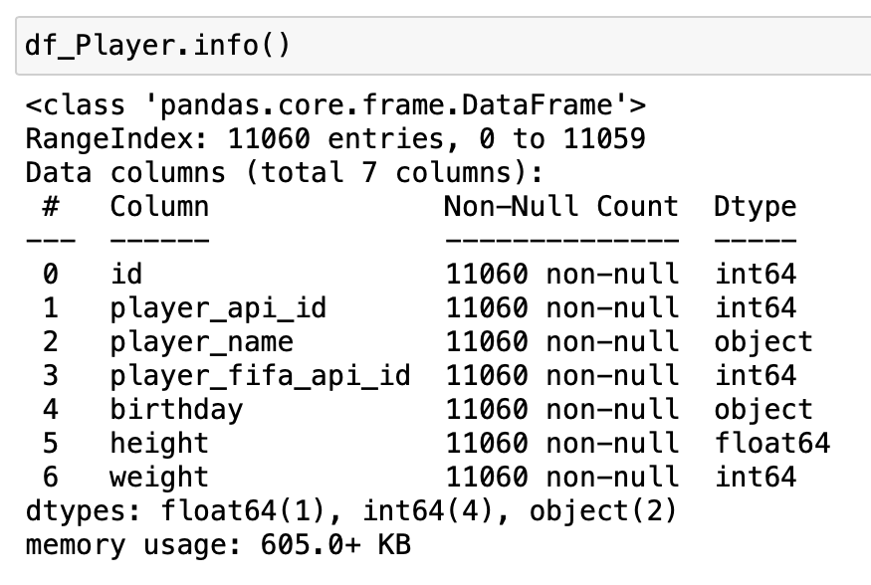
PLAYER ATTRIBUTES
PLAYER INFO
OUTPUT VARIABLE : OVERALL_RATING

Slide 6
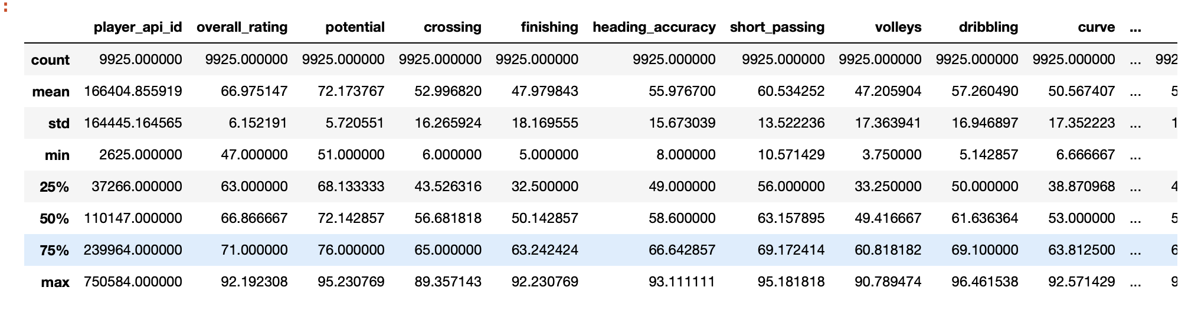
NUMERIC STATS

Slide 7
INITIAL SCHEMA OBSERVATIONS
PLAYER_ATTRIBUTES: 1) MISSING VALUES EXIST 2) MULTIPLE INSTANCES OF PLAYERS WITH SAME ID BUT DIFFERENT FEATURE ATTRIBUTES
PLAYER_INFO : 1) NO MISSING VALUES 2) PLAYERS WITH SAME NAME EXISTS 3) NO DUPLICATES ACROSS ALL COLUMNS

Slide 8
EXPLORATORY DATA ANALYSIS
PREPROCESSING AND VISUALIZATION
PLAYER ATTRIBUTES:
DROPPED ALL ROWS WITH NULL VALUES IN ANY OF THE COLUMS
DROPPED SPECIFIC INSIGNIFICANT ID COLUMNS
MEAN IMPUTED FOR A COMMON PLAYER_ID FOR FLOAT VARIABLES AND TOOK THE MODE FOR CATEGORICAL VARIABLES
REDUCED THE CATEGORY SIZE BASED ON FREQUENCY DISTRIBUTION
ITERATIVE CHECK FOR UNIQUE AND NULL VALUES ACROSS ALL COLUMS AFTER EACH STEP
USED LEFT JOIN TO JOIN PLAYER_ATTRIBUTES AND PLAYER_INFO ON ‘PLAYER_ID’

Slide 9
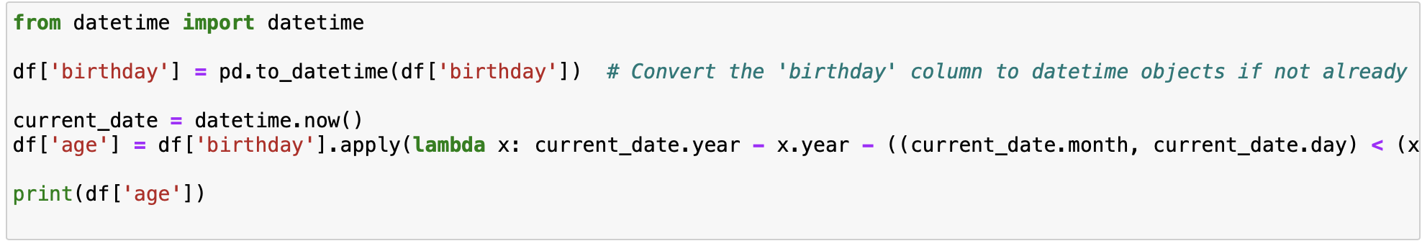
FEATURE ENG. AND GRAPHS
df = final_df.merge(df_Player, on='player_api_id', how='left')

Slide 10
BAR-PLOTS, CORRELATION MATRIX, SCATTER PLOTS, LINE PLOTS

Slide 12
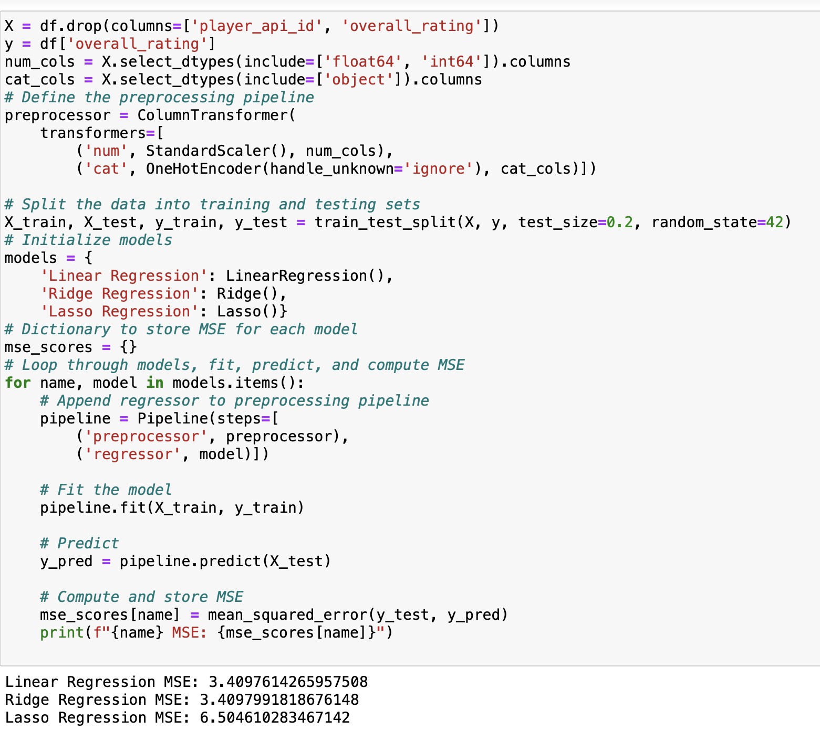
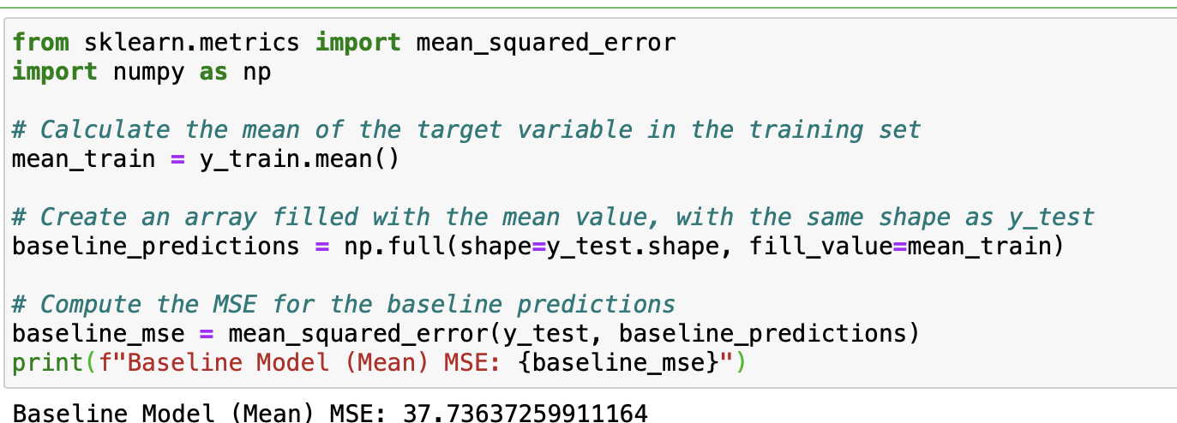
Modeling
Baseline, Linear, Lasso and Ridge Regression

Slide 13
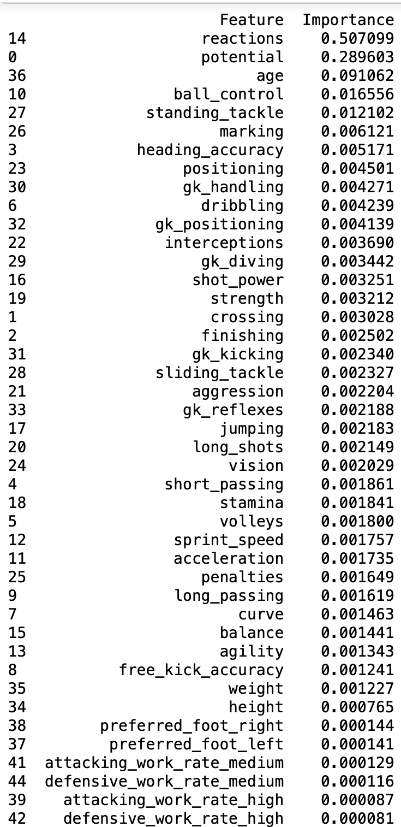
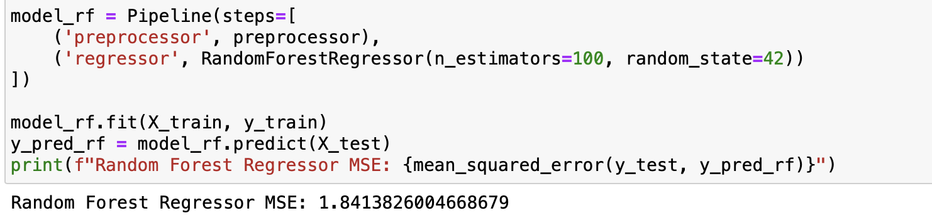
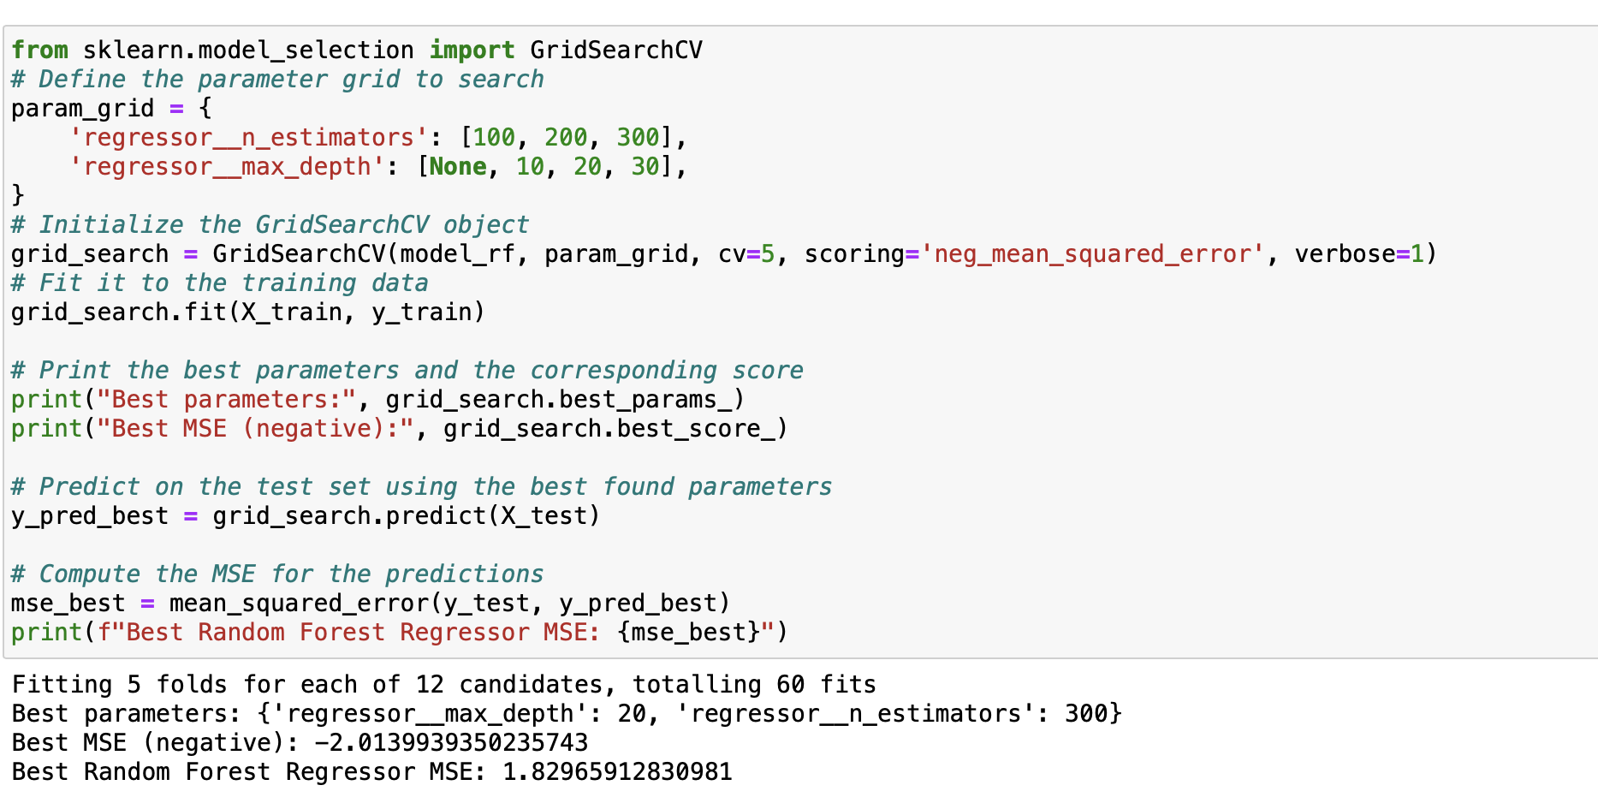
RANDOM FOREST BASE , HYPER-PARAMETER TUNING, FEATURE IMPORTANCE

Slide 14
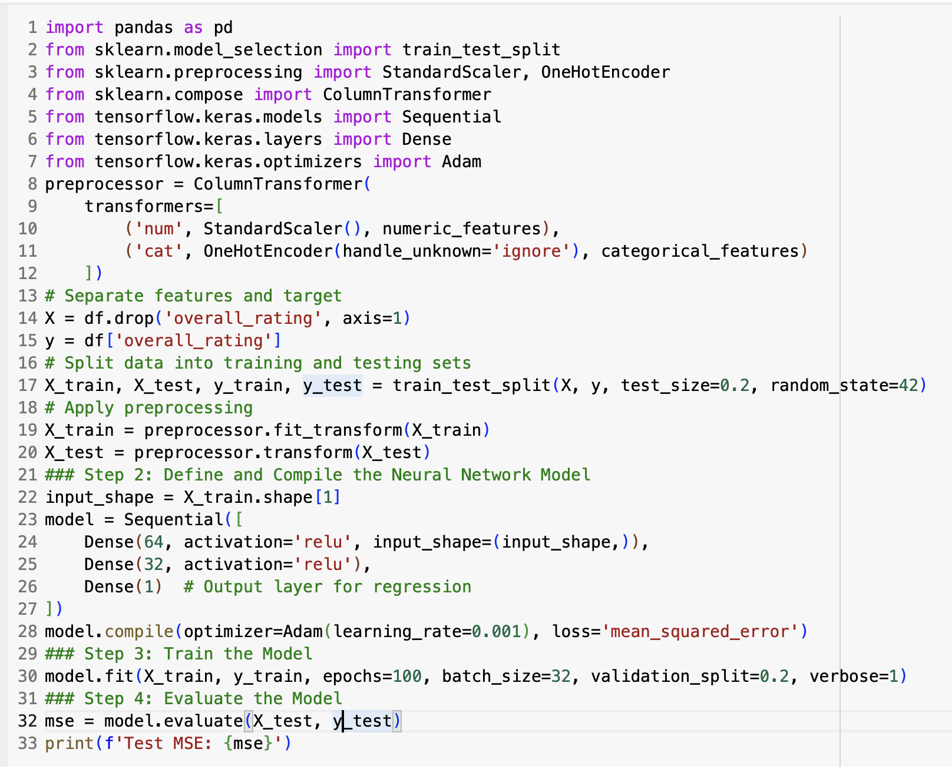
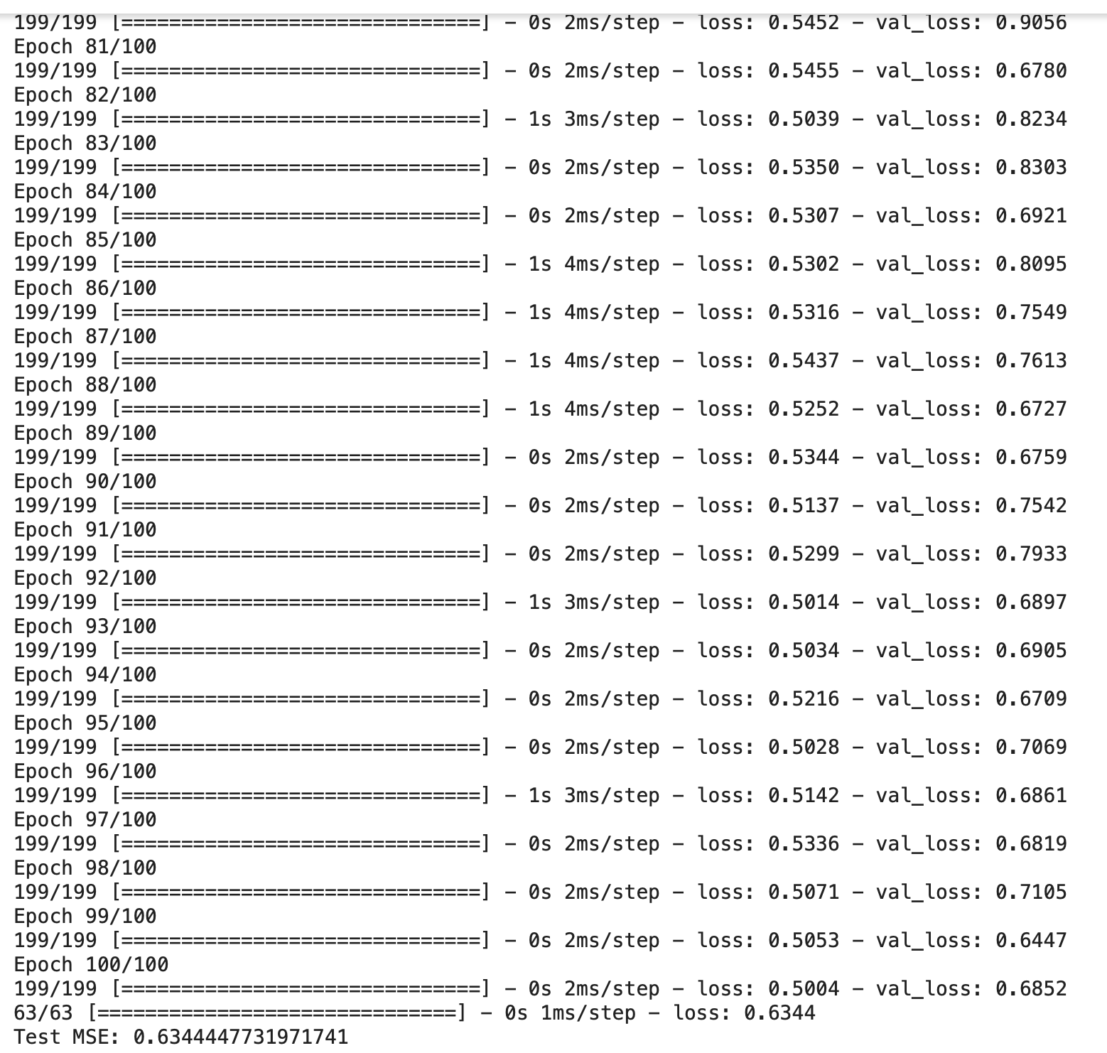
Neural Nets

Slide 15
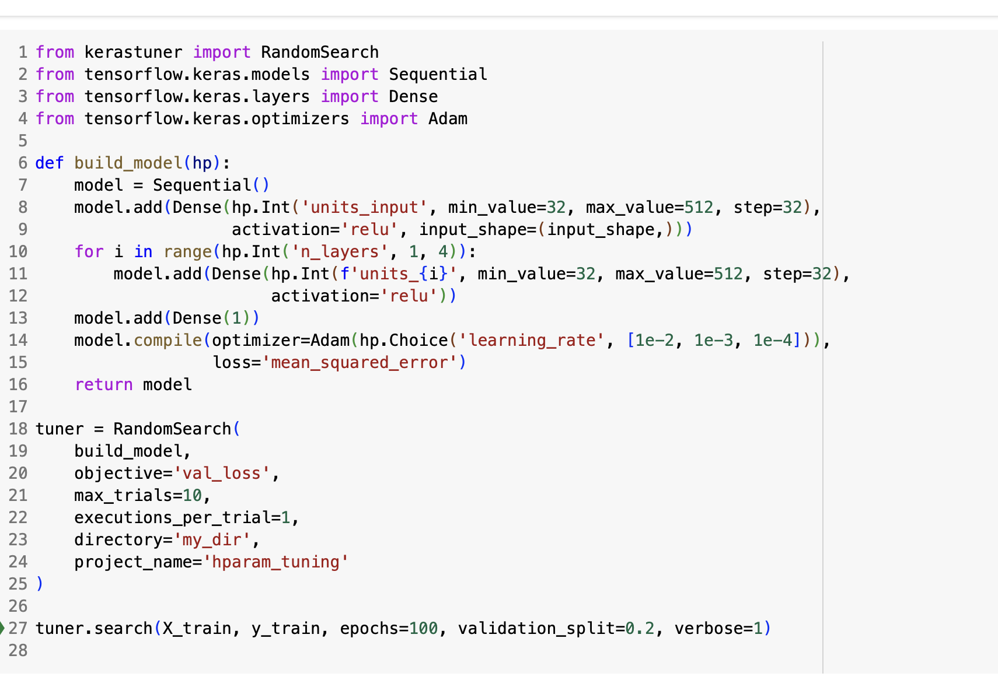
NN- Hyperparameter Tuning

Slide 16
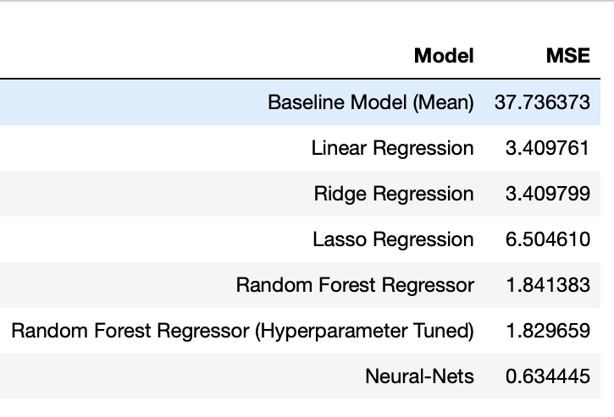
MSE COMPARISON

Slide 17
OBSERVATIONS
THERE IS LINEARITY PRESENT AMONG FEATURES AND TARGET VARIABLE WHICH IS A GOOD FACTOR FOR LINEAR MODELS AND HENCE WHY LINEAR MODELS PERFORM MUCH BETTER THAN THE BASELINE
THERE’S A GOOD DEGREE OF MULTICOLLINEARITY PRESENT BETWEEN FEATURES WHICH EXPLAINS WHY RANDOM FOREST REGRESSOR AND NEURAL NETS OUTPERFORM LINEAR MODELS
EVEN THOUGH THERE IS GOOD DEGREE OF COLLINEARITY, LINEAR MODELS STILL PERFORMS WELL UNDERLYING THE IMPORTANCE OF LINEARITY IN DATASETS FOR LINEAR MODELS
LINEAR AND RIDGE OUTPERFORM LASSO (RIDGE CONSIDERS COLLINEARITY BUT INTRODUCES REGULARIZATION WHICH MAKES IT PERFORMANCE EQUAL TO LINEAR). SINCE FEATURES ARE SIGNIFICANTLY LINEAR WITH TARGET AND LASSO WORKS TO DROP SOME OF THESE, IT ENDS UP PERFORMING WORSE
NN CAN AUTOMATICALLY LEARN AND DERIVE MEANINGFUL REPRESENTATION OF FEATURES FROM RAW DATA THROUGH THEIR HIDDEN LAYERS WHICH ENHANCES PERFORMANCE WITHOUT THE SPECIFIC NEED OF FEATURE ENGINEERING

Slide 18
RECOMMENDATIONS
NN OUTPERFORMS OTHER MODELS IN THIS DATASET WHICH HAS COMBINATION OF LINEARITY, MULTICOLLINEARITY AND NON-LINEAR RELATIONS WITH THE FACT THAT THE DATASET INTRINSICALLY DOES NOT MAKE COMPLETE PRACTICAL SENSE. NN ARE COMPUTATIONALLY EXPENSIVE SO UNLESS THE DATASET IS HUGE WITH LOTS OF COMPLEXITIES RANDOM FOREST REGRESSOR WOULD BE A BETTER OPTION.
WITH LOW COLLINEARITY AND IMPORTANT FEATURES WHICH SHOULD NOT BE DROPPED LINEAR AND RIDGE REGRESSION WOULD BE PREFERRED
IN HIGH DIMENSIONAL DATASETS, LASSO’S ABILITY TO FEATURE SELECT BECOMES VALUABLE.
IF A BALANCE IS DESIRED BETWEEN FEATURE SELECTION AND NOT COMPLETELY ELIMINATING FEATURE COEFFICIENTS WE WOULD IDEALLY GO FOR RIDGE REGRESSION. THE NATURE OF THE DATASET ALSO PLAYS A VERY IMPORTANT ROLE IN THIS

